Slide 1
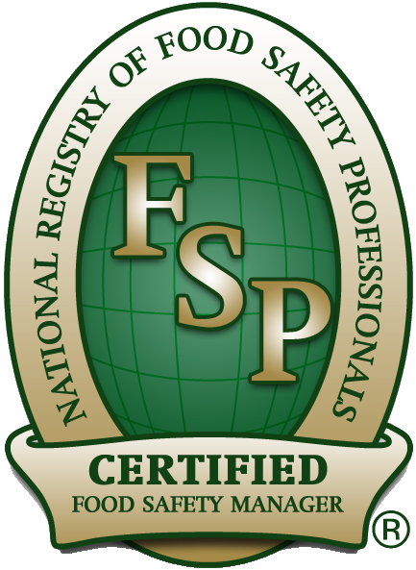
NRFSP Food Safety First Principles for Food Handlers
Approved Program Provider Training Course
{YOUR COMPANY NAME}
{YOUR COMPANY LOGO}

Slide 2
Food Safety First Principles: for Food Handlers Certificate Program
This course takes approximately 1-2 hours to complete
Course consists of 4 Parts:
Part 1 = 30 slides
Part 2 = 26 slides
Part 3 = 25 slides
Part 4 = 31 slides
ALL slides must be viewed before taking the Assessment
A 40-question assessment must be taken and passed (with a score of 70% or more) at the end of this Program

Slide 3
Part 1
This section covers:
Food Safety
Foodborne Illness
Bacteria
FATTOM
The Temperature Danger Zone

Slide 4
Consumer Awareness
Outbreaks of foodborne illness and questions about food and health have often been in the headlines in recent years. But despite better public awareness, the number of cases of foodborne illnesses are still a cause for concern.

Slide 5
Food Safety and the Law
Employers have legal obligations to provide various facilities at work, such as hand washing sinks, in the interest of food safety. They should also ensure that all food service employees are given instruction and/or training and supervision that is appropriate to the work they do.
In recent years food legislation has concentrated on methods that identify and stop, or reduce, the risks to food safety in every workplace. This is known as hazard analysis. A formal system called Hazard Analysis Critical Control Point (HACCP) is used more and more widely.

Slide 6
Your part in Food Safety
If you work with food, you are responsible for ensuring that you do not endanger the safety of food. This is a legal and moral responsibility. In general, your part in food safety is likely to include:
Keeping yourself and your workplace clean
Protecting food from anything that could cause harm
Following good habits, such as washing your hands before handling food
Staying alert to food safety hazards
Following the rules for food safety in your workplace and working with care

Slide 7
First Principles Review
Food safety protects everyone
Poor food safety threatens health, reputations, profits and jobs
Everyone who works with food has a responsibility to safeguard food so that it does not cause illness or harm

Slide 8
Microbiology and Illness
Foodborne illnesses are caused by eating or drinking contaminated food. The symptoms often affect the stomach and intestines causing an uncomfortable and weakening experience. This section outlines the main causes of foodborne illnesses and their symptoms.

Slide 9
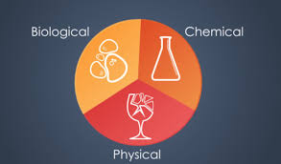
Causes of Foodborne Illness
Food makes people ill when it is contaminated. Food is contaminated when it contains or carries something that is harmful to human health.
There are three main types of food contamination:
Biological
Chemical
Physical

Slide 10
Biological Contamination
Biological contamination is caused by very small life forms, such as bacteria, which are known as microorganisms.
Bacteria are often responsible for biological contamination and they cause more cases of foodborne illness that result in hospitalization and death than any other contaminant. There are thousands of bacteria throughout the natural world.
Most do not harm humans at all. But a few types, referred to as pathogenic bacteria, can cause disease. They include Salmonella, Staphylococcus Aureus, Listeria and Clostridium Botulinum.

Slide 11
Biological Contamination
There are biological contaminants apart from bacteria. They include:
Viruses – microorganisms that multiply in living cells, causing foodborne illnesses such as Hepatitis A and Norovirus.
Norovirus is the cause of the most cases of foodborne illness in which the source is known.
Mold - some types can produce toxins (poisons) on foods such as nuts
Parasites - microorganisms that live on and in people, animals and other organisms. They are a particular problem in hogs and can cause trichinosis in pork
Naturally poisonous plants, fish and shellfish - these include some types of mushroom, as well as some marine fish and shellfish (such as mackerel, snapper, mussels and clams) that cause ciguatera poisoning in humans because they have eaten poisonous plankton (marine microorganisms).

Slide 12
Symptoms, Onset Period and Duration
When your body detects that you have eaten something harmful, it usually tries to get rid of the food by the quickest method. The most common symptoms of foodborne illnesses are:
Abdominal pain
Diarrhea
Vomiting
Nausea
Other signs of illness may include fever and headache.

Slide 13
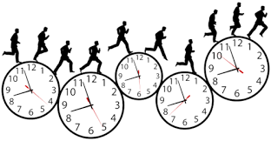
Symptoms of Foodborne Illness
The symptoms of many foodborne illnesses start a few hours to several days after eating the contaminated food. They tend to last 24 to 48 hours, but can continue for a week or more. There are also foodborne illnesses with incubation periods of weeks or even months. For example, the symptoms of listeriosis, caused by Listeria monocytogenes, may take from one day to ten weeks to develop.
The symptoms of some illnesses linked to food can last for months or even years. The infection can invade the blood stream, causing serious long-term health problems and symptoms such as kidney failure or paralysis, which can lead to death.
Foodborne illness outbreak is defined as the occurrence of two or more cases of a similar illness that resulted from eating a common food.

Slide 14
People Most at Risk
Anyone can be affected by a foodborne illness but some people are particularly at risk. The most vulnerable groups are:
The very young
The elderly
People who are ill or recovering from illness
People who have weakened immunity to disease
Pregnant women and nursing mothers

Slide 15
Food Allergies and Intolerance
A food allergy is when a person’s immune system reacts to a food allergen (a type of protein). Some symptoms of food allergies may be similar to foodborne illness symptoms. Other allergy symptoms include rashes, swelling of the throat and mouth, difficulty in breathing, collapse and unconsciousness.
Allergic reactions can occur rapidly after eating just a small amount of a food or ingredient that may be life threatening. Among the foods that have been linked to allergic reactions are nuts and seeds and products made from them, such as salad dressings and cakes, shellfish, food dyes and flavor enhancers, milk and dairy products, chocolate, fruit, and flour.
Food Intolerance - Some people are particularly sensitive or have an intolerance for certain foods and become ill after eating products which are harmless to most other people. A food sensitivity or intolerance is a digestive system problem and is not the same as a food allergy.
Most people who have a food allergy or intolerance know what to avoid, but may need help in identifying exactly which ingredients have been used. It is essential that food handlers respond honestly and directly when questioned about the presence of possible allergens. This is particularly important if a food handler is uncertain as to whether or not a potential allergen is present in a food.

Slide 16
First Principles Review
Foodborne illness is caused by eating contaminated food
The most common symptoms of foodborne illness are abdominal pain, diarrhea, vomiting and nausea. Other severe symptoms include paralysis and kidney failure
Foodborne illness can be life threatening
People who are very young, very old, pregnant, ill recovering from illness or who have a compromised immune system are particularly at risk from foodborne illness
Pathogenic bacteria are the most common cause of foodborne illnesses that result in hospitalization or death.
Some foodborne illnesses are caused by pathogenic microorganisms that are carried by food and water

Slide 17
Bacteria
Bacteria are invisible life forms that live on and in our bodies and throughout the natural world.
There are thousands of different types of bacteria, many serving useful purposes. However, a very small proportion are harmful and cause foodborne illnesses or make food spoil.

Slide 18
Living with Bacteria
Bacteria are single celled microorganisms that are too small to see without the help of a powerful microscope. Even when food is contaminated, it is impossible to see bacteria with the naked eye or to taste or smell them. Food that appears to be safe could make you ill or even cause death.
Although bacteria are responsible for many foodborne illnesses, it is important to remember that not all types of bacteria are harmful. Indeed, most types are beneficial and humans would find it difficult to survive without them

Slide 19
Pathogenic Bacteria
These are the types of bacteria that cause illness, are the cause of foodborne illness, and are responsible for the most number of cases that result in hospitalization or death.

Slide 20
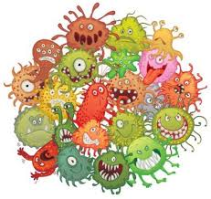
Where Pathogenic Bacteria Come From
The types of pathogenic bacteria that cause foodborne illness come mainly from:
Raw foods, especially meat, poultry, eggs, shellfish and vegetables
Pests and pets
People
Air and dust
Dirt and food waste
Water

Slide 21
Critical Factors that Allow Bacteria to Grow
Foodborne illnesses occur when food is:
Eaten after it has been contaminated by pathogenic bacteria
and conditions allow the bacteria to multiply to levels that cause illness or to produce toxins
and the bacteria or toxins are not destroyed, for instance by adequate cooking (toxins are rarely destroyed by cooking, which is why it is so important to prevent bacterial contamination in the first place)

Slide 22
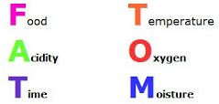
Critical Factors that Allow Bacteria to Grow
When pathogenic bacteria spend enough time on the right types of food at ambient room temperatures, they can quickly multiply to levels which are harmful to health. The ideal conditions for bacteria involve six main requirements:

Slide 23
FATTOM: Food
Like all living things, bacteria need nutrients. Although different types of pathogenic bacteria can live on a range of foods, most prefer something that is high in protein and moist. Such foods include meat, poultry, shellfish, eggs, milk and dairy products and products made from them. These foods promote bacterial growth even if they are cooked and served cold later.

Slide 24
FATTOM: Acidity
Levels of acidity also affect bacteria. Lemon juice, vinegar and other acidic products make it difficult for most bacteria to multiply and are therefore useful for preserving food.

Slide 25
FATTOM: Temperature
Most pathogenic bacteria multiply rapidly at temperatures between 41° F and 135° F. This range of temperatures is therefore called the Temperature Danger Zone. Ambient room temperatures are generally within the danger zone and the ideal temperature for bacterial multiplication is about 98.6° F, which is average human body temperature.
At temperatures colder than 41° F and hotter than 135° F, bacterial growth slows down or stops. However, most bacteria can survive cold temperatures and resume multiplication later when conditions are more suitable.
Freezing makes most bacteria dormant (inactive), but it does not kill them. When frozen food is thawed, it is susceptible to the same risks as fresh food.

Slide 26
FATTOM: Temperature (continued)
Cooking at high temperatures kills most bacteria, provided that the food is cooked for long enough throughout the product. However, it is also important to remember that high cooking temperatures do not destroy all toxins or spores, so danger can remain even after cooking.
Some types of bacteria form spores - a kind of protective coating - to survive cooking and other harsh conditions, such as dehydration and disinfection that would otherwise destroy them. Bacteria do not multiply when they are in spore form but as soon as conditions become more suitable (for example, in the temperature danger zone). Some bacteria may emerge from their spore condition and are free to resume multiplication.

Slide 27
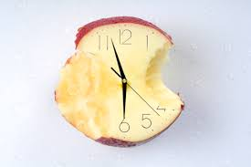
FATTOM: Time
Bacteria do not need long to multiply to levels that cause foodborne illness. They reproduce by dividing. One bacterium splits in two, then two become four and four become eight and so on. As bacteria need only ten to twenty minutes to multiply to harmful numbers, it is possible for one bacterium to lead to the production of millions of bacteria within a few hours.

Slide 28
FATTOM: Oxygen
Some bacteria, referred to as ‘aerobes’, need oxygen to reproduce. Others referred to as ‘anaerobes’, thrive without oxygen. There are also some bacteria that can live either with or without oxygen.

Slide 29
FATTOM: Moisture
Pathogenic bacteria need moisture to stay alive. They cannot multiply in dried foods. However, as soon as liquid is added to foods such as dried eggs and powdered milk, the reconstituted products provide ideal conditions for bacterial growth. Quantities of salt (in foods such as crackers and bacon) and sugar (in foods such as candy, jelly and jam) absorb the moisture available in the food so that the bacteria cannot use the moisture and multiply.

Slide 30
The Temperature Danger Zone
As most pathogenic bacteria multiply rapidly at temperatures between 41° F and 135° F, TCS foods and perishable foods should be kept out of the danger zone as much as possible. Foods are likely to be at danger zone temperatures when they are:
Left on work surfaces
Left in sunlight, for instance in a display window
Heated slowly
Cooled slowly

Slide 31
The Temperature Danger Zone
Food is also likely to be in the danger zone when hot and cooler foods are combined - for instance, when hot gravy is poured on cold food.
It is important to remember the basic rules, which are often called the time and temperature rules:
Minimize the time that TCS Foods are kept at danger zone temperatures
Keep cold foods cold
Keep frozen foods frozen
Keep hot foods hot

Slide 32
First Principles Review
You cannot see, smell or taste pathogenic bacteria even when they have contaminated food
Pathogenic bacteria need food, acidity, temperature, time, oxygen, and moisture to multiply
The bacteria responsible for foodborne illness can multiply to harmful levels every 10 to 20 minutes in ideal conditions
Pathogenic bacteria multiply at temperatures between 41° F and 135° F, the temperature range known as the danger zone
Effective temperature control helps to prevent foodborne illness
End of Part 1

Slide 33
Part 2
This section covers:
Time-Temperature Control for Safety Foods (TCS)
Contamination
Causes
Prevention
Time and Temperature Control

Slide 34
Time-Temperature Control for Safety Foods
Some products described as (TCS) Time-Temperature for Safety Foods, are more likely to cause foodborne illnesses than others. It is important to be able to recognize them so that you can deal with them with special care and prevent illness.

Slide 35
Time-Temperature Control for Safety (TCS) Foods
Time-Temperature Control for Safety Foods support the rapid growth of infectious or toxigenic microorganisms when conditions are ideal - particularly when protein-rich moist food is left at danger zone temperatures for some time. The foods may be of animal, plant or synthetic origin and may be raw or heat treated. Examples of TCS include:
Cooked meat and cooked poultry
Cooked meat products - such as stews, gravy and soups made with meat or meat stock
Meat or fish salads
Milk and eggs and uncooked and lightly-cooked dishes made with them - such as mayonnaise and hollandaise sauces and custards
Shellfish and seafood - including fish, shrimp, mussels’, clams, oysters, crab, and lobster
Cooked rice
Raw seed sprouts
Cut melons, cut leafy greens and sliced tomatoes
Garlic and oil mixtures that have not been processed to prevent the growth of pathogenic microorganisms

Slide 36
Time-Temperature Control for Safety (TCS) Foods
As the name suggests, these are in a form that can be eaten at once. This means that they are not treated in any way (such as by cooking) that would destroy pathogenic bacteria immediately before the food is eaten. Many, but not all, ready-to-eat foods are Time / Temperature Control for Safety Foods.

Slide 37
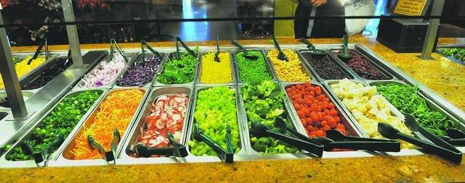
Dealing with TCS Foods
All food should be treated with care. When dealing with TCS food, it is particularly important to:
Avoid touching the food by barehand - use utensils whenever possible or wear appropriate gloves
Keep raw, TCS and ready-to-eat foods apart - raw foods are major sources of pathogenic bacteria
Cover the food during storage to prevent contamination
Keep the food out of the danger zone (41° F to 135° F) whenever possible during preparation, service or sale - to prevent bacterial growth in numbers or the formation of toxins

Slide 38
First Principles Review
TCS foods need temperature control because they easily support the growth of pathogenic bacteria
TCS foods must be kept out of the danger zone as much as possible
Preventing contamination is a major part of food safety
High standards of food safety help prevent foodborne illness

Slide 39
Contamination and Prevention of Illness
Contamination is the presence of something harmful or objectionable in food or drink which creates a risk of illness, injury or discomfort. No one wants to eat contaminated food and the law says that people who work with food must protect food from contamination.

Slide 40
Causes of Contamination
Food contamination is caused by three groups of contaminants which are described as:
Biological
Chemical
Physical
Biological contaminants are the main cause of foodborne illnesses

Slide 41
Examples of Sources of Contamination
People
Pathogenic bacteria can be found on hands and in ears, the throat and hair. They are also in cuts, pimples and boils. You can spread bacteria by touching your face, hair or other parts of your body before handling food
Even clean perfectly healthy people may carry pathogenic bacteria and viruses which can be spread to food by poor personal hygiene habits
Coughing and sneezing can spread pathogenic microorganisms over a wide area
Poor personal hygiene habits, such as not washing hands after going to the bathroom, can spread foodborne illnesses. This is often referred to as fecal-oral route of contamination

Slide 42
How Contamination Occurs
Even the simplest or least processed food could go through several stages before reaching the consumer’s plate and some products go through many stages before they are sold. Among the stages could be growing, slaughtering, harvesting or catching, processing, packing, delivering, storing, preparing, cooking, displaying, selling and serving.

Slide 43
How Contamination Occurs
It is easy to see how physical and chemical contamination could arise during one or several of these stages - for example, a screw from badly maintained food machinery could drop into food or poorly controlled pest bait could contaminate food in storage. But biological contamination is an invisible problem that occurs when:
Raw foods, such as poultry and vegetables, are contaminated by bacteria found in the natural environment
Pathogenic bacteria are transferred from a raw food to a ready-to-eat food, at any stage - this is known as cross-contamination

Slide 44
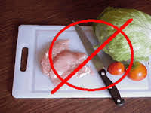
How Contamination Occurs
Other examples of cross-contamination include when:
A raw food touches a TCS food or ready-to-eat food
Liquid or juices from a raw food drip onto a TCS food or onto a ready-to-eat food

Slide 45
How Contamination Occurs
Bacteria can move, but they cannot travel far on their own. They are moved from one place to another on people, animals, equipment and utensils, in particular by:
Hands
Work surfaces, containers, dishes and utensils
Utensils and equipment, such as cutting boards and wiping cloths
Any food contact surface that has not been cleaned and sanitized properly between uses
These are sometimes referred to as ‘vehicles of contamination’. They move pathogenic bacteria from a contaminated source, such as raw meat, to a place with ideal conditions for multiplication - moist protein-rich food which is kept for sufficient time at room temperature.

Slide 46
Preventing Bacterial Contamination
Bacterial contamination often leads to foodborne illness and is the cause of the most cases of foodborne illness that result in hospitalization and death - and it takes only a small number of pathogenic bacteria, such as Campylobacter and E. coli 0157, to cause illness. It is therefore particularly important to ensure that:
Raw, cooked, ready-to-eat and TCS foods are kept apart at all times including storage, transportation, preparation and display
All surfaces that come into contact with raw food are thoroughly cleaned and sanitized after use

Slide 47
Preventing Bacterial Contamination
Food service establishments use a number of methods to help prevent cross-contamination. Some use color-coded preparation equipment such as cutting boards and knives. Each color is designated for a particular use. For example, red could indicate that a cutting board must be used for raw red meat only, while green could indicate use for vegetables only. Yellow could be used for chicken, white for ready-to-eat foods and blue for seafood. The color coding helps remind everyone to prepare raw and TCS foods using separate equipment. (Color-coded equipment must, of course, still be cleaned and sanitized after every use.)

Slide 48
Prevention Checklist
The list below summarizes ways to prevent physical, chemical and biological contamination. As you will see, some measures safeguard against more than one type of contamination.
You may not be involved in all the actions needed to prevent contamination at your workplace. For instance, you may not be responsible for choosing reputable suppliers. However, as everyone who works with food has a responsibility to safeguard food from harm, it is important to understand the general principles involved.
Keep food covered until use
Use utensils to move food
Avoid touching food with your bare hands unless absolutely necessary. Wear disposable gloves when required

Slide 49
Prevention Checklist (continued)
Separate raw and cooked foods at all times, including storage, transportation, preparation and display
Use separate equipment and utensils for the preparation of raw meats and poultry and other foods if possible
Wash all raw vegetables, fruit and rice before use
Undo packaging in an area away from food
Keep food areas clean. Clean and sanitize all equipment, utensils and other food contact surfaces after every task involving food
Maintain food areas and food equipment in good condition - report any signs of problems to your supervisor immediately
Remove food waste and trash frequently throughout the day and dispose of it safely and hygienically
Report any signs of food pests to your supervisor immediately
Keep cleaning chemicals in secure, clearly labeled containers in non-food storage

Slide 50
Prevention Checklist (continued)
Follow manufacturers’ instructions for cleaning chemicals - use the correct chemical for the job and follow the methods and quantities specified
Check that snaps, buttons, and name badges are properly secured to clothing
Avoid keeping pens or other items in pockets, hats or behind your ears
Do not wear jewelry
Do not smoke, eat, drink or chew gum in food areas - you could transfer bacteria from your mouth to your hands then onto food
Follow strict personal hygiene habits, including:
Keeping yourself clean and wearing suitable clean clothing
Washing your hands frequently
Keeping any cuts, boils or similar skin problems properly covered

Slide 51
First Principles Review
Contamination is the presence in food of something that should not be there, such as pathogenic microorganisms
Food can be contaminated by biological, physical and chemical contaminants
Pathogenic microorganisms are the main cause of foodborne illness
Contamination occurs in the natural environment and can also be caused by cross-contamination
Bacteria cannot travel on their own. ‘Vehicles of Contamination’ that allow bacteria to travel include hands, work surfaces, cutting boards, wiping cloths, knives and any equipment or utensil that has not been cleaned and sanitized between uses

Slide 52
First Principles Review (Continued)
The main source of pathogenic bacteria are: contaminated raw foods (especially meat, poultry, eggs, shellfish and vegetables), contaminated water, pests and pets, people, air, dust and food waste
Even clean healthy people carry pathogenic microorganisms on and in their bodies and they can be a major source of contamination
People who work with food must keep themselves clean, wear suitable clean clothing and follow food safety practices
Safeguard food by doing everything possible to:
Prevent contamination
Stop pathogenic microorganisms from multiplying
Destroy pathogenic microorganisms

Slide 53
Controlling Time and Temperature
Temperature control involves restricting the time that TCS foods are left at temperatures in the danger zone and using high temperatures to kill pathogenic microorganisms.
The basic rules of good practice are:
Restrict the time that TCS foods spend at danger zone temperatures
Keep cold food cold, ideally at 41°F or below
Keep hot food hot at 135° F or above

Slide 54
How to Keep Food out of the Temperature Danger Zone
The longer that TCS food is at danger zone temperatures, the more chances bacteria have to produce toxins or multiply to levels that cause illness. Food is likely to be in the danger zone if it is left at ambient temperatures. In addition, food passes through the danger zone while it is being cooled, thawed or heated. It is essential to:
Make sure that food is at a safe temperature when delivered to your workplace
Refrigerate raw, highly perishable and TCS foods immediately after delivery
Keep refrigerated food in storage until it is needed for preparation or serving
Cook food thoroughly
Keep hot food hot until it is served
Cool hot food that is intended for eating cold as rapidly as possible so that the food spends the shortest possible time in the danger zone
Thaw frozen food under refrigeration
Reheat food adequately

Slide 55
Keeping Food at Safe Temperatures
There are slightly different rules for food temperature and time controls in different states, so it is important to check and to follow the regulations governing the establishment where you work. Owners, managers and supervisors must ensure that everyone who works with food knows the relevant temperature and time requirements for their work activities. They must also ensure that violations do not occur.

Slide 56
Checking Temperatures
There are various types of temperature recording devices. Some built-in thermometers record the temperature automatically. Other types, such as probes, have a dial display or digital read-out. All food service establishments should check food, refrigeration and freezer temperatures regularly and keep records of the readings. Thermometers must be cleaned and sanitized after use.

Slide 57
Temperature Control
Minimum cooking temperatures for common foods include:
• Fish - minimum internal temperature of 145° F
• Ground Beef and Pork - minimum internal temperature of 155° F
• Poultry - minimum internal temperature of 165° F

Slide 58
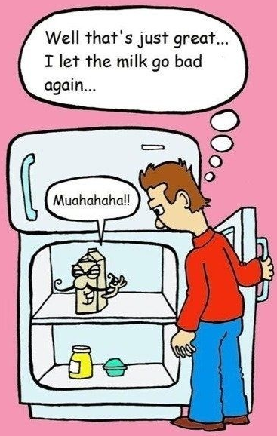
Poor Temperature Control
It is worth remembering that poor temperature control frequently leads to foodborne illness. Some bad practices are also violations. The problems are most frequently caused by:
Cooling hot food too slowly before refrigeration
Reheating food inadequately
Preparing food too far ahead of sale or service and keeping it at an ambient (room) temperature
Leaving food out on work surfaces at an ambient temperature instead of refrigerating it
Under-cooking meat, poultry and eggs
Thawing frozen food incorrectly
Holding hot food at a temperature below 135° F for periods of time that allow bacterial growth in numbers

Slide 59
First Principles Review
Think ahead - allow enough time for thawing, cooking and cooling - and aim to serve or sell the food immediately after it has been prepared
Leave food in storage until it is needed
Prepare the quantity of food most likely to be required, to avoid wasting it or storing it unnecessarily
Follow the basic rules of time and temperature control at all times: don’t leave TCS foods at danger zone temperatures any longer than strictly necessary
Keep hot food hot, at 135°F or above
Keep cold food cold, ideally at 41°F or below
End of Part 2

Slide 60
Part 3
This section covers:
Preparing and Presenting Foods
Spoilage and Preservation
Delivery and Storage

Slide 61
Preparing and Presenting Food
An extensive selection of food is available from a wide variety of sources including fast food outlets and restaurants, supermarkets and convenience stores. Regardless of the circumstances in which food is prepared, displayed, sold or served, it must remain safe to eat, appetizing and nutritious. People who work with food are responsible for keeping food safe to eat, so it important to know what you should do. You may not be involved in all the activities mentioned, but it is important to remember the general principles for food safety and to follow the rules at your workplace.

Slide 62
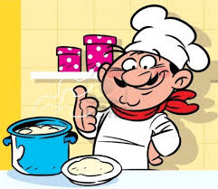
Cooking
Manufacturers often produce food in identical portions to help ensure that every item is cooked safely, but it is up to you to check before cooking.
All cooked food must be heated properly, so that every part of the food is hot enough for long enough to reduce pathogenic microorganisms to safe levels. The safe temperatures and cooking times required are specified in regulations covering your workplace. Managers and supervisors must make sure that all food service employees understand and follow the rules.
Whenever possible, cut large roasts and poultry into smaller portions to ensure that they cook evenly through to the center. Cook stuffings separately so that they do not prevent the poultry or meat from cooking properly through to the center. Stir stew and casseroles during cooking to ensure that there are no cool spots at temperatures in the danger zone. This is especially important when a microwave oven is used.

Slide 63
Cooling Hot Food
Hot food passes through the temperature danger zone as it cools, so you must reduce the temperature as quickly as possible. Managers and supervisors must ensure that employees cool hot food to the temperature specified in the local regulations within the time required.

Slide 64
Methods for Quickly Cooling Food Based on the FDA Food Code
Place food in shallow pans
Separate food into smaller or thinner portions
Use rapid cooling equipment
Stir food in a container placed in an ice water bath
Use containers that help heat transfer away from food
Add clean fresh ice as an ingredient

Slide 65
Thawing Frozen Food
Many foods may be cooked safely from frozen if the manufacturer’s instructions are followed. Some large, raw frozen items, such as meat and poultry should be completely thawed before cooking.
Inadequate thawing may lead to foodborne illness. If ice remains in poultry or meat, the food surface may cook while the temperature inside remains at a danger zone temperature - ideal for bacterial growth.

Slide 66
Thawing Frozen Foods
Wherever possible, thawing should take place in a specifically designed thawing cabinet or refrigeration unit set aside for the purpose. If you have to use multipurpose refrigeration for thawing, always place frozen raw foods on the lowest shelf to prevent juices from dripping onto other foods and contaminating them.

Slide 67
Precautions for Reheating Foods
Reheated food is a common cause of illnesses linked to food. Problems occur if the food is not heated sufficiently, particularly if the initial cooking, cooling and storage were inadequate. If food does not get hot enough quickly enough, bacteria have an ideal temperature at which to multiply.
Remove food from refrigeration just before reheating and serving and not any earlier. Always follow instructions on prepared food.
Never reheat food more than once and discard any left-overs.

Slide 68
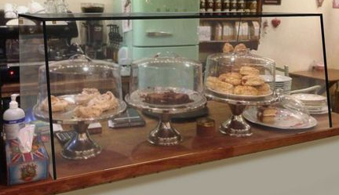
Display Food
Food displayed for sale or service must be protected against all sources of contamination. Packaged foods must be securely wrapped. Open food must be covered by lids, or protected by a sneeze guard.

Slide 69
First Principles Review
All cooked food must be heated properly, so that every part of the food is hot enough for long enough to reduce pathogenic microorganisms to safe levels
Hot food passes through the temperature danger zone as it cools, so you must reduce the temperature as quickly as possible.
Inadequate thawing may lead to foodborne illness
Reheated food is a common cause of illness linked to food
Never reheat food more than once and discard any leftovers
Food displayed for sale or service must be protected against all sources of contamination

Slide 70
Spoilage and Preservation
All food gradually goes through a natural process of aging, called spoilage. For thousands of years people have used techniques, such as drying, salting and smoking, to combat spoilage and to prolong the period when food is safe, appetizing and nutritious to eat. This describes the part that modern preservation methods play in food safety.

Slide 71
Spoilage
Spoilage starts from the moment food is slaughtered or harvested, because of the action of microorganisms and fungi including mold and yeast.
Some foods spoil faster than others but the speed of deterioration can be controlled by preservation methods and safe food handling practices. However, food spoilage may also be accelerated by damage from careless handling; inappropriate storage, especially poor temperature control; and contamination by stored product pests, other pests or chemicals.

Slide 72
Fungi
Some types of fungus, such as mushrooms are eaten as food. Others are used in food production. For example, certain types of mold help to produce blue-veined cheeses, some soft cheeses and soy sauce. While different types of yeast are used for making bread, beer, and vinegar. However, the presence of unwanted yeast or mold (some of which produce toxins) can spoil food, making it unfit for human consumption.

Slide 73
Recognizing Spoiled Food
Spoiled food is sometimes easy to recognize. Typical signs include:
Discoloration, including dark or pale patches
Visible mold
Changes to the usual smell, often unpleasant
Changes in texture, including wrinkling and drying, softening and becoming pulpy
Alteration of the usual flavor, including sourness
Some of the conditions that accelerate spoilage, such as poor temperature control, also allow pathogenic bacteria to multiply. The food may look and smell good, but may be unsafe to eat.
The problems of serving or selling spoiled food include:
Causing a foodborne illness
Violations, because it is illegal to sell spoiled food
Gaining a poor reputation by serving food that is unappetizing
Selling food that has lost nutritional value

Slide 74
Code Dates
Food is often labeled with a date indicating the period when the food is safe to eat. There are many types of code dates including use by, best before, sell by, display and production dates. Code dates help ensure that food is eaten when it is safe to eat and in its best condition. Some code dates are legally enforceable, and it is unsafe to ignore a code date - you could make someone very ill.

Slide 75
First Principles Review
Spoilage starts from the moment food is slaughtered or harvested
Spoiled food is sometimes easy to recognize
Some of the conditions that accelerate spoilage, such as poor temperature control, also allow pathogenic bacteria to multiply. The food may look and smell good, but may be unsafe to eat
All the steps needed to prevent contamination and multiplication of pathogenic microorganisms also help delay food spoilage
A number of preservation methods delay spoilage or kill the spoilage organisms that can make food unfit to eat
Code dates help ensure that food is eaten when it is safe to eat and in its best condition

Slide 76
Delivery and Storage
Food needs constant care until it is sold or served, including the time during delivery and storage. It is important to handle and store food in the best possible way - in the right conditions, at the correct temperature and for a safe length of time.

Slide 77
Dealing with Food Deliveries
Every food business should have guidelines for accepting or rejecting food deliveries. The guidelines will vary from food to food, but the key points are to ensure that the food is fresh, is contained in clean, undamaged packaging, is free from pest infestation and has been maintained at the correct temperature. Deliveries must be checked as soon as they arrive and the food must be stored immediately afterwards. Reasons for rejecting a delivery include:
TCS or perishable foods delivered at a danger zone temperature
Frozen food thawed or partly thawed
Packaging damaged, dirty or wet
Cans dented, bulging, rusty or leaking
Signs of mold or other forms of spoilage
Expired code date

Slide 78
The Purpose of Storage
Most food businesses have to store food, even if that storage period is brief. Correct storage, when food is kept in the right conditions, at the correct temperature for the appropriate period, helps to:
Prevent foodborne illness
Preserve the food’s taste, appearance and nutritional value
Provide adequate supplies when they are needed
Avoid spoilage and wasted food
Keep to the budget
Comply with regulatory requirements

Slide 79
General Rules for Safe Storage
There are some important general rules for safe storage:
Store food immediately after the delivery has been checked
Deal with TCS frozen and perishable foods before dry and canned goods
Keep TCS and perishable foods out of the temperature danger zone
Take care as rough handling can accelerate spoilage
Place foods in the appropriate storage areas, following and storage instructions on the label or box
Protect food from contamination

Slide 80
General Rules for Safe Storage (Continued)
Store food at least six inches off the floor on shelves or pallets
Use clean, dry containers and wrappers if food needs to be divided into smaller quantities or rewrapped
Stack shelves carefully without overloading, leave enough space between goods for air to circulate freely
Keep storage areas clean and dry, clean up any spills immediately
Check food regularly and always before you use it
Rotate stored food
Tell your manager about any signs of pests
Separate any food that could be spoiled or has gone past its code date to make sure that it is not eaten and tell your manager. He or she will tell you what to do once the food has been checked: unacceptable food should be returned to the supplier or destroyed
Put cleaning chemicals and materials in separate, clearly labeled storage

Slide 81
Food Rotation
Whenever you are asked to store food or to take something out of storage, you should rotate the food. This involves using a product with the shortest shelf life before using a similar product with a longer shelf life. (You may know of this as FIFO - first in, first out.) When you store or display food, put the products with the shortest shelf life at the front and place products with the longest shelf life at the back. To remove food from storage or display, take the food from the front. Always check the code date, packaging and condition of the food before use.

Slide 82
Foods for Refrigeration
TCS and perishable foods must be refrigerated, because most pathogenic and spoilage bacteria do not multiply or multiply very slowly at refrigeration temperatures (32°F to 41°F).
Examples of foods to be refrigerated:
Raw meat, poultry and fish
Cooked meat, poultry, fish and seafood
Meat, Poultry and fish products
The contents of opened cans of meat, fish, and fruit, once they have been transferred to suitable containers
Raw meat, poultry and fish in vacuum or Reduced Oxygen Packs (ROP)
Milk, dairy products and products containing them (for example, quiches, custards and flans)
Eggs
Prepared salads
TCS foods include vegetables such as raw sprouts, sliced tomatoes, cut leafy greens and fruits such as cut melons
Anything labeled for refrigeration, such as bottled product without preservatives

Slide 83
Loading
If possible, use separate refrigeration for raw foods (such as meat and poultry) and for TCS foods (such as dairy products and raw and cooked meats). Where you have to use multi-purpose refrigeration, always store raw meat and poultry on a shelf below other foods so that juices or blood cannot drip onto other foods and contaminate them.
Load the shelves so that cold air can circulate and you can easily check the food. Don’t leave the refrigeration unit doors open any longer than necessary because the refrigeration temperature will rise.

Slide 84
First Principles Review
Effective food safety includes storing food in the right conditions, at the correct temperature, for a safe amount of time
Spoilage is caused by spoilage bacteria, mold and yeast
Spoilage can be accelerated by careless handling, inappropriate storage and pest infestation
The rotation of food helps ensure that food is eaten while it is safe, wholesome and at its best
Stock rotation involves using food with the shortest shelf life first. This is sometimes known as FIFO - first in, first out.
Deliveries of food should be checked for condition, temperature and shelf life
Food should be stored immediately after the delivery has been checked
End of Part 3

Slide 85
Part 4
This section covers:
Personal Hygiene
Cleaning and Sanitizing
Pests

Slide 86
Personal Hygiene
People are a common source of pathogenic bacteria, so everyone who works with food must have the highest possible standards of personal hygiene and personal habits to avoid contaminating food.

Slide 87
First Impressions
You need to start work clean and neat. This will give a good impression to any customers you meet as well as playing an essential part in helping to protect food from contamination. You must take a bath or shower everyday. This will remove some of the bacteria that are naturally found on hair and skin, including those which live on stale perspiration and cause body odor. Deodorants can assist in preventing unpleasant body smells from developing after you have washed. However, it is essential to avoid strongly scented deodorants, perfumes, aftershaves and other toiletries or cosmetics because they may alter the taste or smell of the food.

Slide 88
Jewelry
Leave jewelry, including watches, at home or in your locker at work because bacteria can live on and under straps and rings, while gemstones and small parts could drop into food. Some companies allow employees to wear a plain wedding ring and very small, plain earrings in pierced ears. Find out your company policy.

Slide 89
Appropriate Clothing
Never wear or carry street clothing into a food area because they could contaminate food or surfaces. Store street clothes away from food areas. Your employer should provide a separate area or locker for that purpose.
Put on protective clothing before entering a food area. Although protective clothing may keep your own clothes clean, this is not their main purpose. Protective clothing is designed to protect food from contamination and you from harm. It should be:
Suitable for the task
Clean and in good condition
Lightly colored, so that dirt will show easily, prompting you to change into clean replacement clothing
Easy to clean

Slide 90
Appropriate Clothing (Continued)
What you need to wear will largely depend upon the type of work you do.
Typical examples include:
Overalls, jackets, trousers, aprons
Neck scarves, hats, hair nets, beard nets, moustache nets
Non-slip shoes, boots, safety shoes
Gloves
Other clothing may also be provided for working in cold environments.
A hat or head covering must cover as much of your hair as possible. You may also have to wear hair nets to contain hair. If you hair is long, it must be tied or clipped back so it cannot hang loose outside the head covering. Beards and moustaches may also need to be covered. Always put on your head covering before you put on other protective clothing to avoid displacing hair. Never brush or comb your hair in a food area.
Do not wear protective clothing outside food areas, such as on your way to work, because you could cause contamination.

Slide 91
Essential Handwashing
Even if you can avoid touching food by hand, you will touch equipment, utensils and surfaces throughout the work period, so your hands must be scrupulously clean at all times.

Slide 92
Essential Handwashing (Continued)
Wash your hands frequently throughout the day and always wash your hands:
BEFORE:
Starting work
Touching raw food or TCS foods
Touching ready-to-eat food
BETWEEN:
Handling raw and cooked food
Handling raw and ready-to-eat food
AFTER:
Handling raw food
Visiting the bathroom
Handling raw eggs in their shells
Coughing, sneezing, or blowing your nose
Touching your hair or face or any other part of your body or clothing
Cleaning or sanitizing, or touching containers of cleaning chemicals
Dealing with trash and containers
Taking a break
Eating, drinking or smoking - (in an area set aside for these activities)
Wearing protective gloves
Handling money

Slide 93
Essential Handwashing (Continued)
Never test food with your fingers or lick your finger tip to make it easier to pick up something.
Do not wear nail polish because it can chip and flake into food and can hide dirt that must be removed before handling food. Do not wear false or bonded nails because they could fall into food.

Slide 94
How to Wash Hands
Most people think they know how to wash their hands, but it is important to understand what proper hand washing involves - and to follow the rules every time!
Your manager should provide you with:
Separate sinks for hand washing
Hot and cold running water
Soap or detergent and nailbrushes
Hand-drying facilities, such as disposable towels
Regular training and reminders about handwashing
Thorough handwashing requires a minimum of twenty seconds of vigorous scrubbing.

Slide 95
How to Wash Hands (Continued)
Twenty seconds may seem a long time to rub soap into your hands, but it really does help remove bacteria. Use a nailbrush to clean fingernails after handling raw foods or going to the toilet. If hand antiseptic lotions or dips are permitted, they are for use in addition to thorough handwashing and are not a substitute for it. Never dry your hands on protective clothing, dishcloths or service cloths, as this could cause contamination.

Slide 96
Cuts and Pimples
Cover cuts, scratches, pimples and acne with a waterproof bandage to prevent spreading bacteria to food and to protect the wound or pimple. Waterproof bandages are ideally brightly colored so that they can be seen easily if they come off. Some bandages contain a thin metal strip so they can be automatically identified by a metal detector on production lines. If a bandage does fall into food, tell your employer immediately.
If you have an infected cut, pimple or boil, you must report this to your employer before you start work.

Slide 97
Reporting Illness
There are a number of legal requirements for reporting illnesses to the regulatory authorities, for exclusion from food establishments when you have certain illnesses or could be infectious, and for returning to work after certain illnesses. You must tell the person in charge at work if you have, or have recently had, a foodborne illness or one with similar symptoms. This is because:
You must not work with food if you have certain illnesses or symptoms - because you could contaminate food
It is a legal requirement to report certain illnesses to the regulatory authorities- your employer should arrange for this to be done
You may need medical attention
You may need a physician’s approval before you can return to working with food

Slide 98
Reporting Illness (Continued)
The person in charge will tell you what to do. You may be excluded from the establishment altogether while you are ill or likely to cause an infection, or you may be prevented from working with exposed food.
Generally speaking, you will be able to go back to work when you:
Are not ill or infectious
Have written approval to return to work from a physician
The person in charge at work has seen the physician’s approval and removes the exclusion

Slide 99
First Principles Review
Keep yourself clean and neat when working with food
Wash your hands regularly throughout the work period. Always wash your hands when they are likely to be contaminated - for example after going to the bathroom or preparing raw meat or poultry
Put on protective clothing before entering a food area
Keep your hair covered
Report symptoms of foodborne illness or any similar symptoms to the person in charge

Slide 100
Cleaning and Sanitizing
Customers expect food premises to be clean and they assume that you handle their food hygienically. Clean and organized workplaces create a good impression as well as helping to make a safe, pleasant environment for everyone. However, it is important to remember that even when something looks perfectly clean, it could be contaminated.

Slide 101
Sanitizing
Sanitizing is the reduction of bacteria to a low, safe level. It can be achieved by the use of:
Very hot water, at about 171° F or hotter
Steam
Chemical sanitizers
Use a Test Strip to determine if solution is too weak or too strong

Slide 102
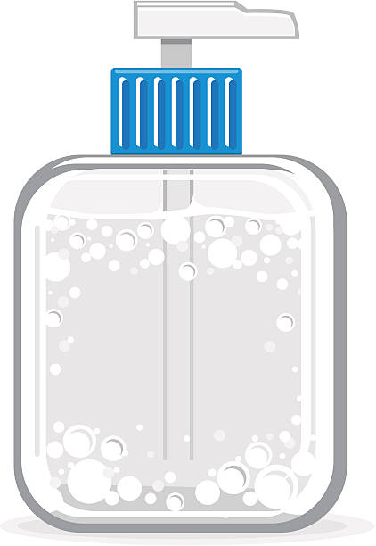
Sanitizing (Continued)
Cleaning chemicals that reduce pathogenic microorganisms to a safe level are called sanitizers. They destroy enough bacteria to safeguard health, even though they cannot kill all pathogenic bacteria and their spores.
Sanitizers must be used after cleaning and rinsing, because they cannot remove grease and dirt. They must be left on the surface for long enough to work properly, this is referred to as the ‘contact time’. The manufacturer’s instructions should state the period of contact time.

Slide 103
What to Sanitize
Sanitize food-contact surfaces including:
Preparation boards, cutting boards, multi-use utensils, tables and work surfaces
Food processing machinery, equipment
Utensils such as spatulas, mixers, mincers, knives and tongs
Containers
Production belts
Sanitize hand-contact surfaces, including:
Handles - for example on doors, refrigeration equipment, freezers, cupboards and drawers
Faucets, soap and paper towel dispensers
Switches
Sanitize contamination hazards and sources of bacterial growth, such as:
Cloths, brushes, scrubbers and mops
Trash containers and their lids

Slide 104
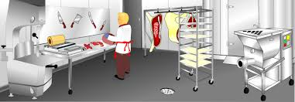
When to Clean and Sanitize
Equipment and areas that are likely to be contaminated by bacteria, such as cutting boards, must be cleaned and sanitized frequently throughout the work period. This is commonly described as ‘clean as you go’ cleaning. It involves cleaning up immediately after every task. For example, you should clean and sanitize work surfaces after preparing raw meat.

Slide 105
Manual Dishwashing
The stages of manual dishwashing and sanitizing
Pre-clean - remove loose and heavy soiling. For example scrape plates and chopping boards, or soak a saucepan
Wash - use hot water and detergent
Rinse - remove any traces of detergent and food particles with clean, hot water
Sanitize - use a chemical sanitizer. Make sure to leave it on for the correct contact time
Air dry - leave items to dry naturally in the air. Drying cloths must not be used because they could remove the sanitizer before it has had time to work, or they could spread bacteria

Slide 106
Simple Safety Precautions
Do not use any chemical without training. Wear protective clothing, such as rubber gloves and goggles that is appropriate to the task. Always follow the manufacturer’s instructions. If you are in any doubt about the safe use of a chemical, ask your supervisor for advice before you start work. Use only the chemicals approved by your employer for the task. Never mix chemicals together - they could explode, cause toxic fumes or ‘burn’ someone’s skin.
Work through the stages of cleaning in a way that does not spread dust or dirt. Avoid being distracted in a way that puts you, other people or food at risk.

Slide 107
Trash Disposal
Food waste and other trash, such as food packaging, can be a source of bacterial and physical contamination and can attract pests if it is not disposed of properly.
There may be two types of trash cans at food establishments - inside ones near food preparation areas and dumpsters in special areas outside. The indoor containers need to be within the food handlers’ easy reach. However, they must not be so close to food that they create a risk of contamination.

Slide 108
Trash Disposal (Continued)
Remove trash throughout the day as soon as each polythene liner becomes full. Tie the bag securely and take it outside to a dumpster. Always put the liners inside the dumpsters, making sure that the lids are on securely to protect the trash from scavenging animals.
Never let a container or dumpster overflow and don’t leave trash inside food establishments overnight - it will attract pests. Keep trash containers, dumpsters, recycling containers, lids and the surrounding area clean. Tell your employer if dumpsters become full: additional dumpsters or collections may be needed.
Always wash your hands after dealing with trash.

Slide 109
First Principles Review
Effective cleaning and sanitizing helps prevent illness and injuries
Food service employees should clean as they go, to prevent contamination, bacterial multiplication and accidents
Detergents dissolve grease and remove dirt, while sanitizers reduce bacteria to safe levels
Food contact surfaces, hand contact surfaces and anything that could cause contamination or provide the conditions for bacterial multiplication, must be sanitized after cleaning
All employees must follow safety procedures when working with cleaning chemicals so that they protect food from contamination and people from injury
Trash containers should be emptied regularly throughout the work period
Bags of trash should not be left lying around outside because they could attract pests

Slide 110
Pests
Pests are attracted to places where food is stored, prepared, sold, served or thrown away, and where there is warmth and shelter. They can enter buildings through open windows and doors, or through cracks in walls and around windows and pipes.
A pest is any creature that lives on, or in, human food, causing damage or contamination or both. Pests are a source of food contamination. The main ones are:
Insects - such as flies, moths, ants, cockroaches and wasps
Stored product pests - such as beetles, mites and weevils
Rodents - rats and mice
Birds - mainly pigeons, sparrows, starlings and seagulls

Slide 111
Pets
Dogs, cats, hamsters, birds and other pets can contaminate food. There have been cases of foodborne illness where someone has contaminated food after handling pets. Pets must not be allowed in any food facility unless they are a ‘service animal’ on duty

Slide 112
Preventing Problems
You can play an important part in preventing problems by:
Keeping food covered at all times
Storing food off the floor in appropriate containers
Never leaving food outside
Checking deliveries carefully - some pests have entered food premises in packaging, vegetables, fruit, cereals and grain
Checking stored goods regularly and rotating stored food
Reporting any damaged (torn, pierced or gnawed) packaging
Storing food waste in garbage containers with securely fitting lids
Maintaining a clean workplace - paying special attention to food preparation areas, stores, drains and dumpster areas - and cleaning as you go ensuring that you clear up any spilled food immediately
Keeping door and window screens closed
Telling your manager about any holes in walls or around windows, doors, pipes

Slide 113
The Evidence of a Problem
Prevention is always better than the cure, but it is also important to watch out for signs of pests. Do so regularly and particularly while rotating stored food, cleaning and dealing with trash. Report any sightings of pests or signs of trouble to your employer immediately. The main signs are:
Dead bodies (mainly insects, rodents and birds)
Droppings
Unusual smells
Scratching, pecking or gnawing sounds (mainly rodents and birds)
Gnawed pipes, cables and fittings
Torn or damaged sacks or packaging,
sometimes surrounded by spilled food
Eggs, larvae, feathers, fur, nesting material
Paw or claw prints
Rub marks and rat runs (rodents)

Slide 114
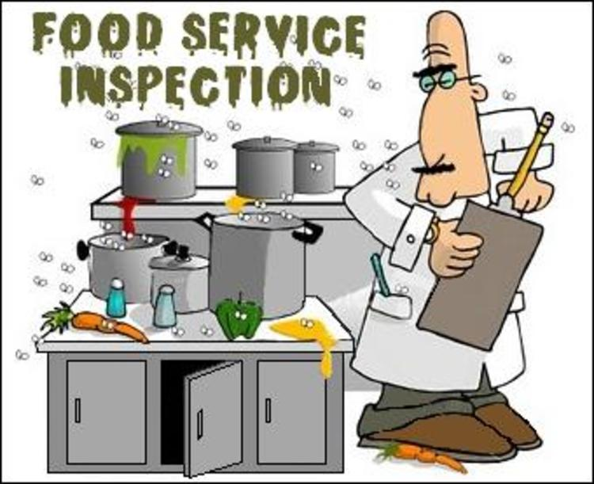
Food Inspectors
Regulatory Food Inspectors have the authority to enter a food facility and conduct an inspection.

Slide 115
First Principles Review
Food premises attract pests because they contain almost everything they need to survive
Pests are a source of pathogenic bacteria
Effective pest control includes preventing pests from getting into premises, protecting food from contamination, cleaning thoroughly and taking immediate action to deal with a suspected infestation
Food service employees should report sightings and signs of pests to their employers
It is dangerous to interfere with any pest prevention measures or equipment
End of Part 4
End of Course Training

